Slide 1
Tweet Sentiment Analysis - Istraživanje tekstualnih podataka - Mihailo Joksimović, 2017/430059
UNIVERZITET SINGIDUNUM
DEPARTMAN ZA MASTER STUDIJE

Slide 2
Big-data pipeline

Slide 3
Goals
Setup a Pipeline with Kafka
Run sentiment analysis
Display results on frontend

Slide 5
Tech stack
Python
Kafka
ElasticSearch
Backbone.js & Chart.js

Slide 6
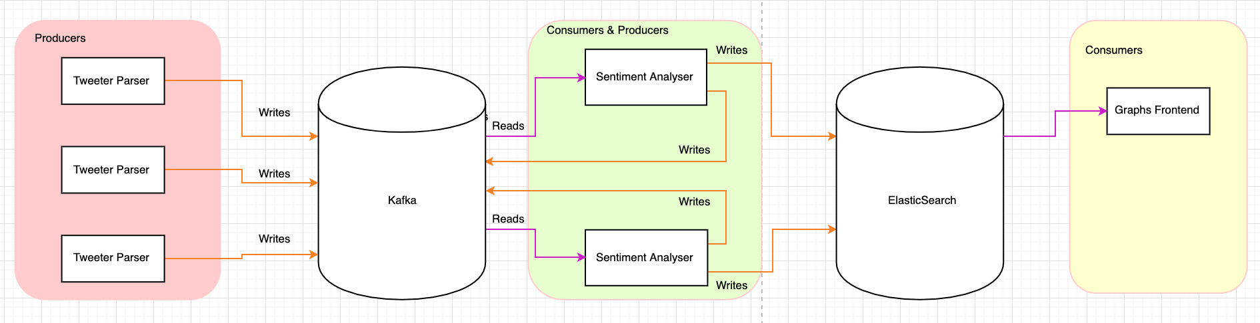
Pipeline

Slide 7
Sentiment Analyser
AFINN Score for Polarity
NRC Lexicon for sentiments

Slide 8
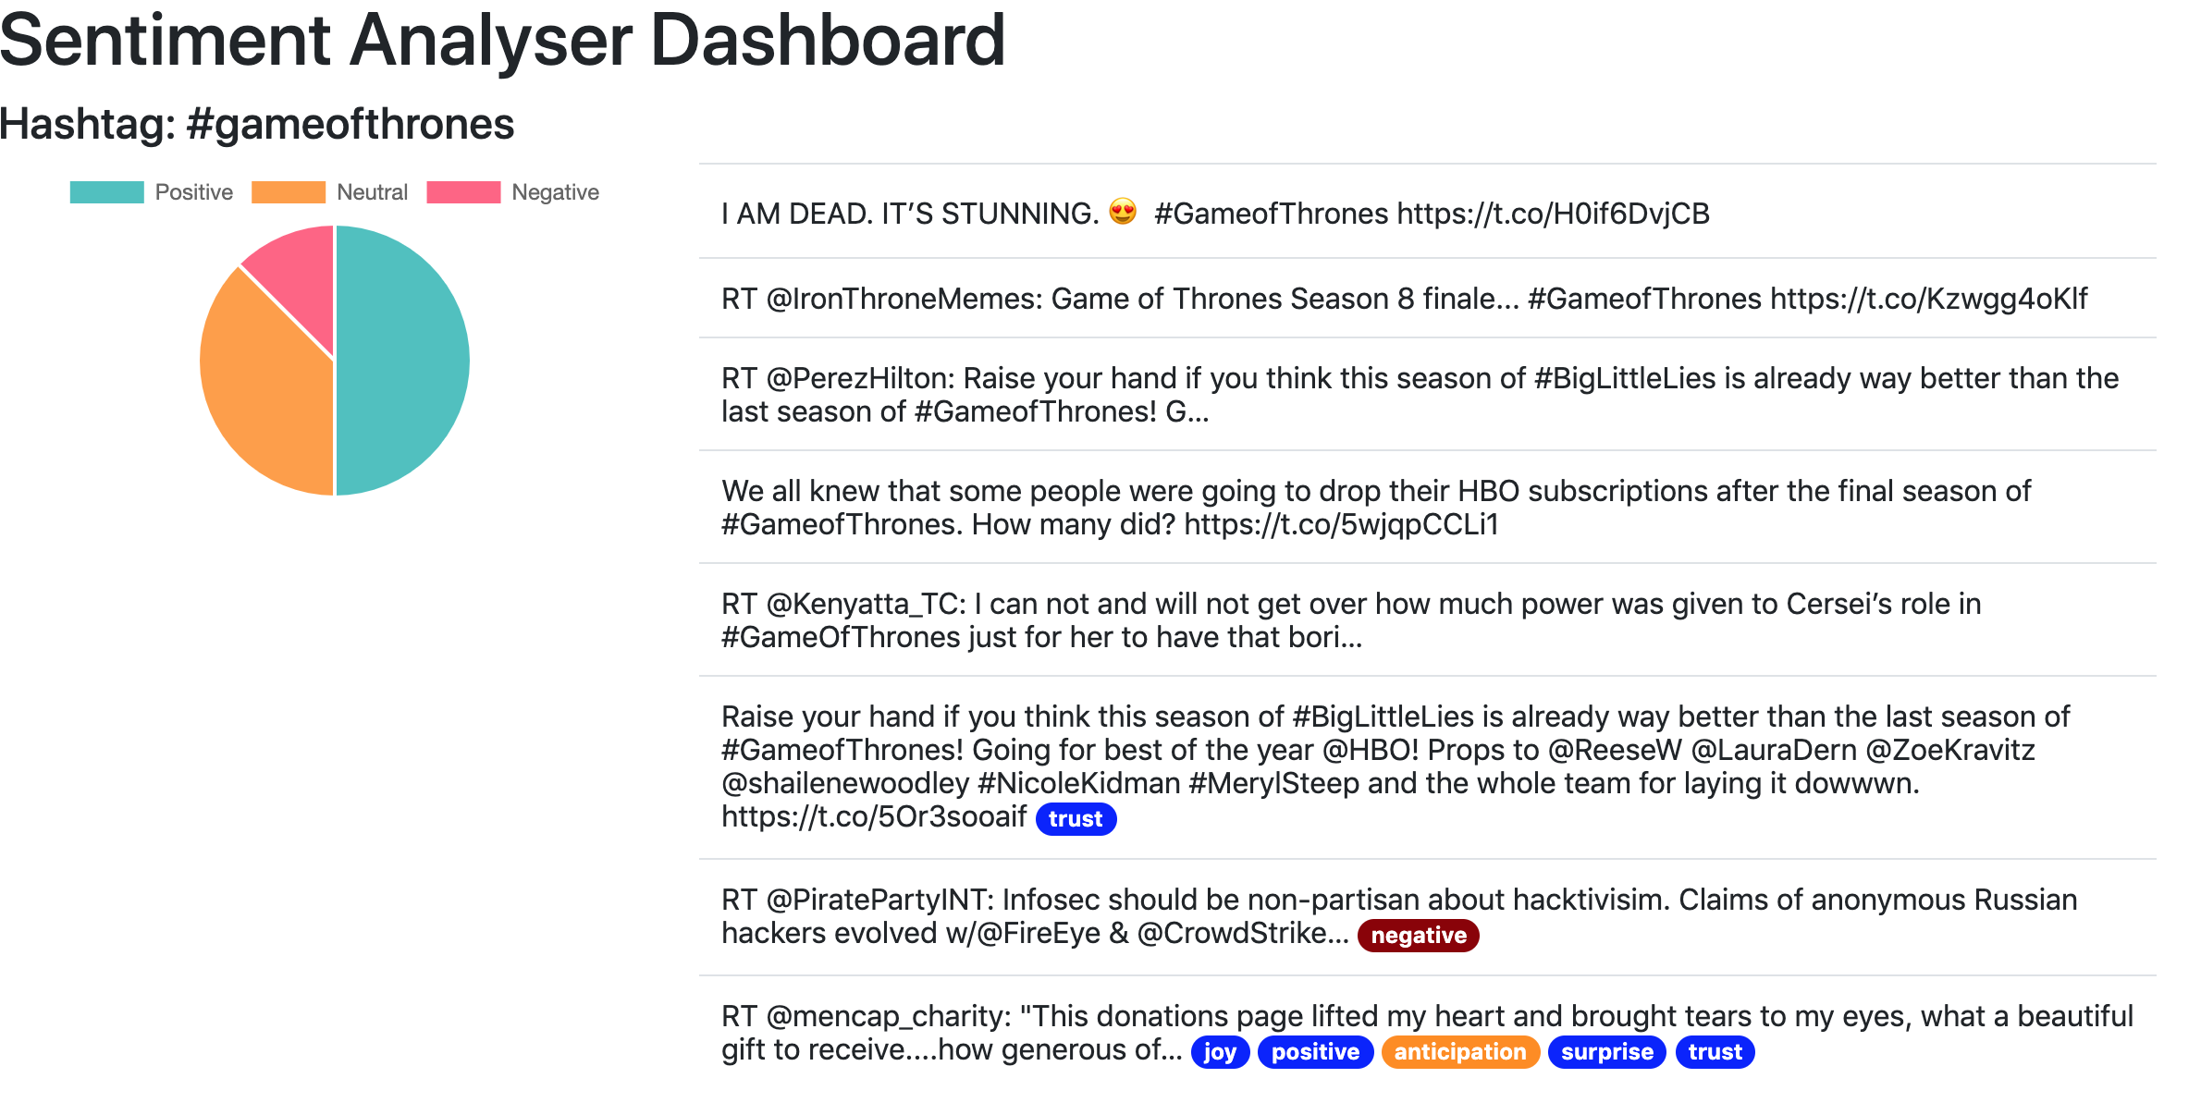
Result

Slide 9
Classification

Slide 10
Plan
Fetch tweets for #happy and #sad hashtags
Vectorize using TF-IDF
Classify whether tweet is “happy” or “sad”

Slide 11
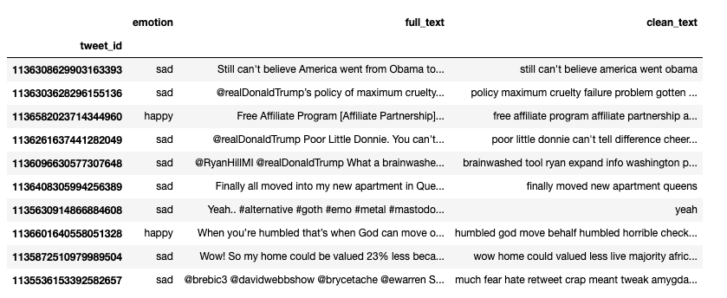
Data

Slide 12
Try #1
TF-IDF without num. of features specified
MultinomialNB classifier
3200 training samples, 1067 test samples
8971 features extracted using TF-IDF

Slide 13
Results
0.75 accuracy score
Pretty bad results. Most of tweets classified as “sad”

Slide 14
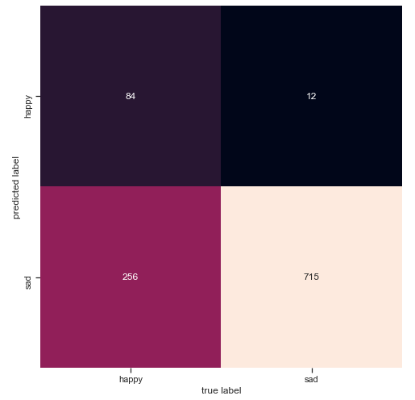
Confusion matrix

Slide 15

TF-IDF with 1000 features
Accuracy: ~0.76
Still bad for “happy” category

Slide 16

TF-IDF with 100 features
Accuracy: ~0.71
Even worse for “happy” category

Slide 17
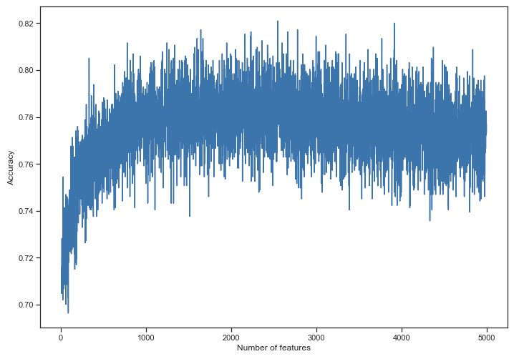

Slide 18
SVM?

Slide 19
Results
Apparently even worse …
Increasing number of features dramatically decreased accuracy …

Slide 20
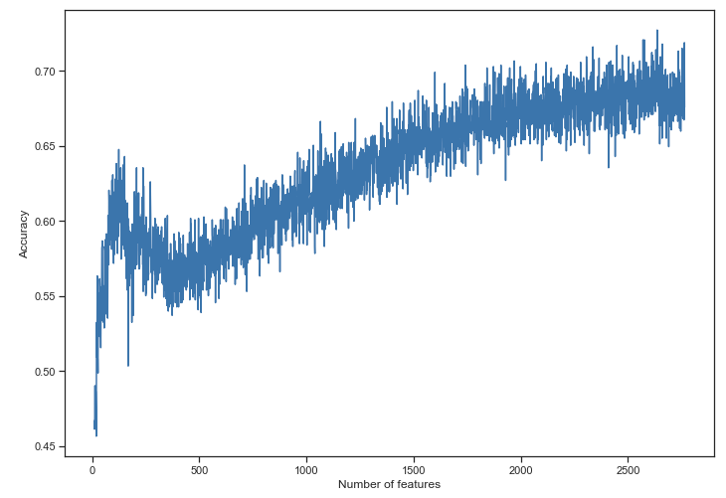
Naive Bayes

Slide 21
Tweet Text Analysis

Slide 22
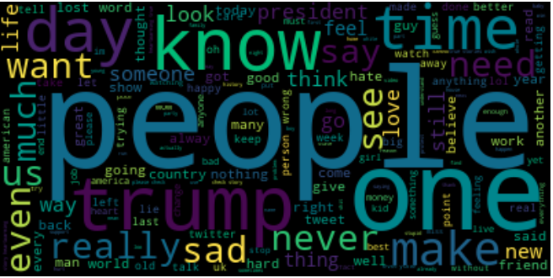
Wordcloud for “sad” tweets

Slide 23
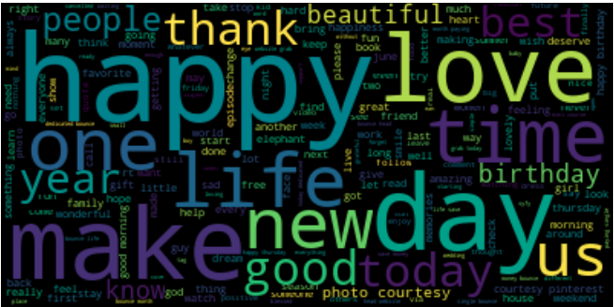
Wordcloud for “happy” tweets

Slide 24
Analysis findings
Noticed that some tweets are duplicates (specifically – 86 of them)
#sad has two-times more tweets than #happy (1242 vs 2853)

Slide 25
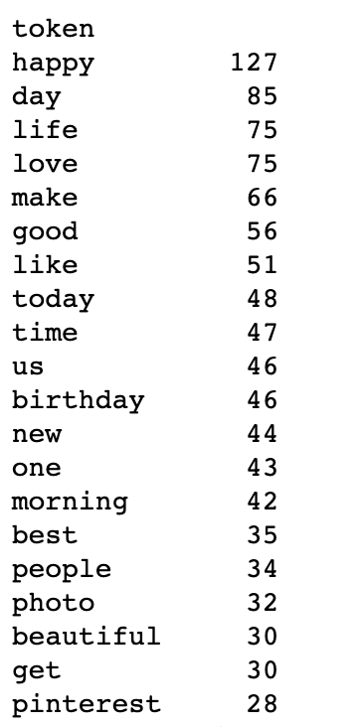
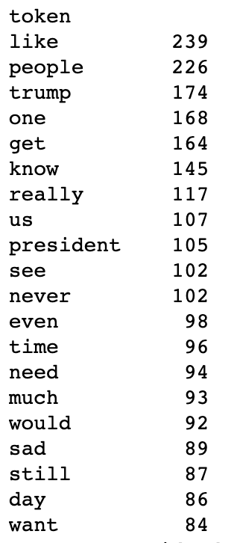
#happy tokens
#sad tokens

Slide 26
Attempt #1 – Counting top token occurrences

Slide 27
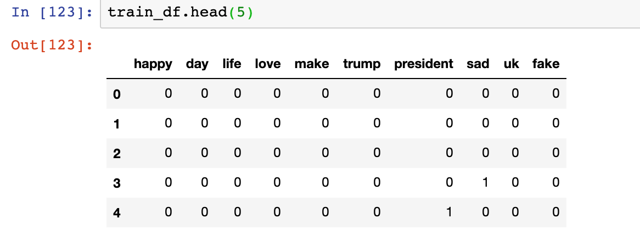

Slide 28
Results
Train score accuracy: 0.74
Test score accuracy: 0.69
Best score: 489 features → 0.81 accuracy score

Slide 29
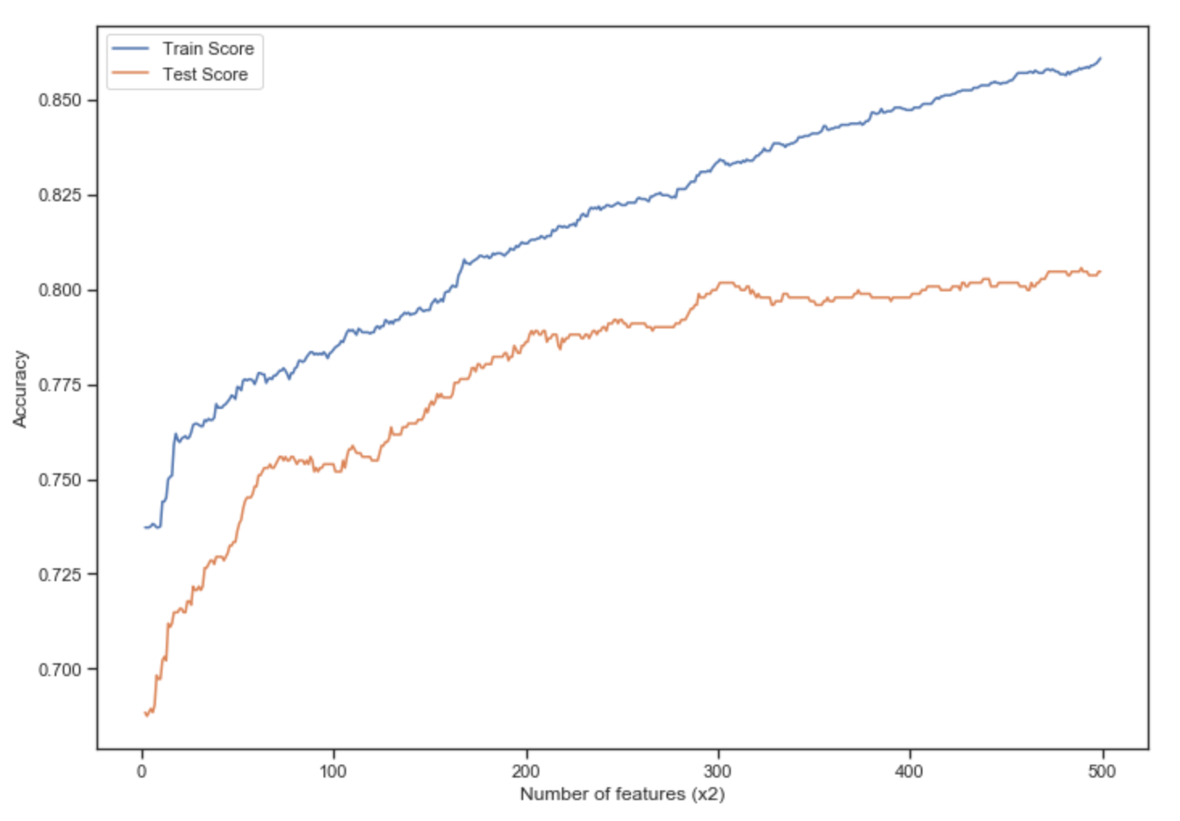
Learning curve

Slide 30
Attempt #2 - Stemming

Slide 31
Results
Stemming produced out-of-the-box better initial accuracy
With 10 features (20 in total):
Train score: 0.73
Test score: 0.74
Best score: 85 features → 0.79 accuracy score
without stemming, similar accuracy achieved with 489 features

Slide 32
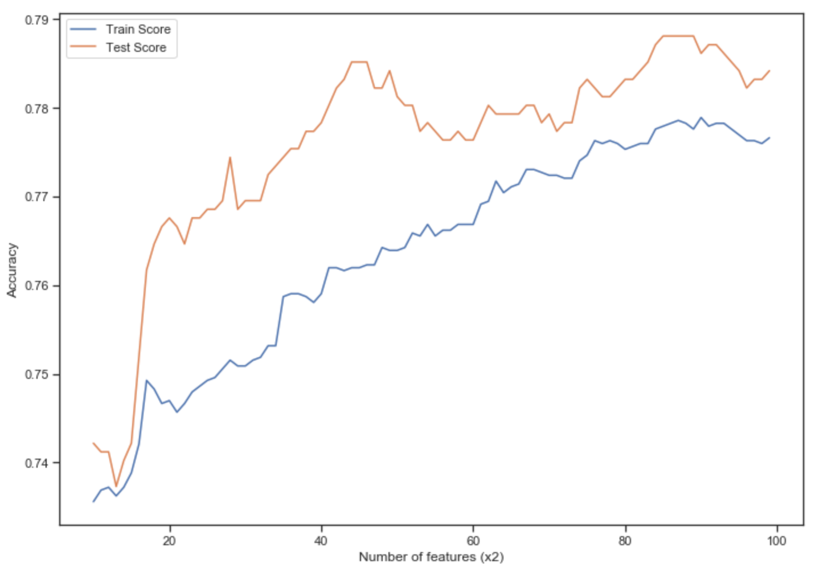
Learning curve

Slide 33
Attempt #3 - Lemmatization

Slide 34
Results
Worse results than Stemming produced
With 10 features (20 in total):
Train score: 0.73
Test score: 0.72
Best score: 89 features → 0.76 accuracy score

Slide 35
Summary
Best overall results (speed vs num. features ratio) gained with Stemming and 85 features (0.79 accuracy score on Test data)
Highest accuracy score (0.81) achieved with simple counting of tokens, but required 489 features to be included

Slide 36
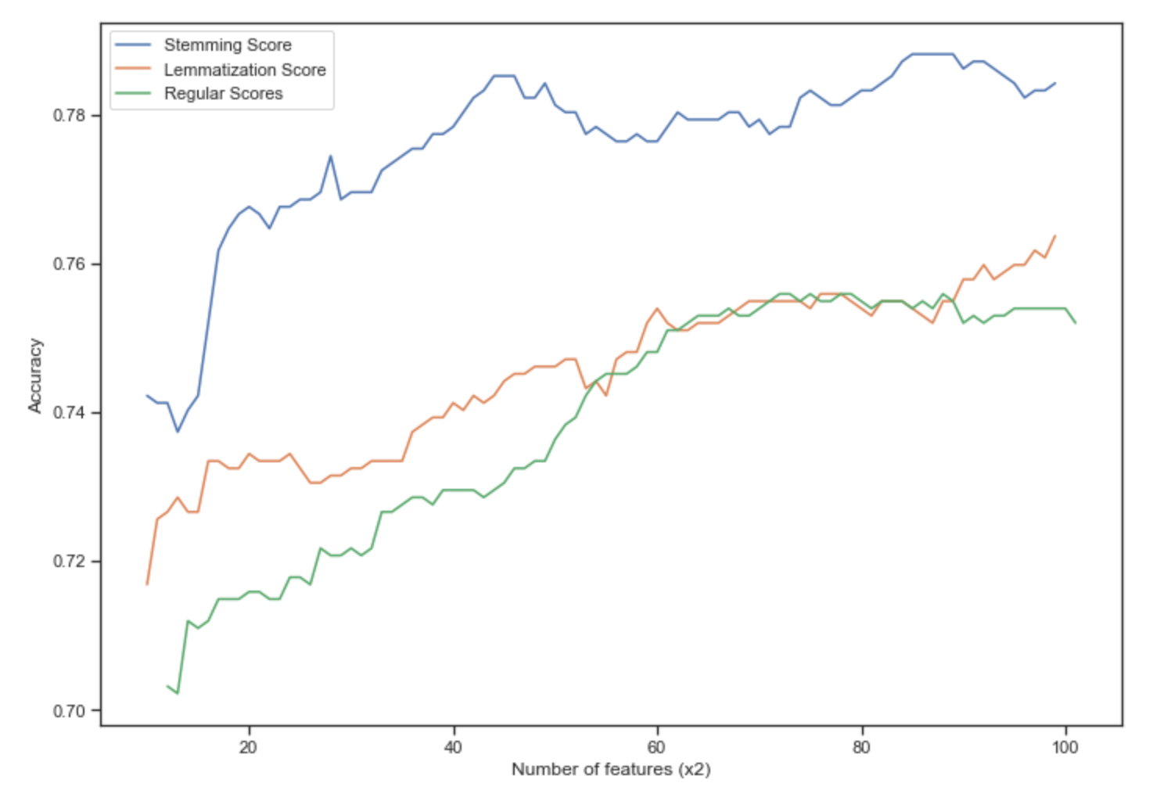

Slide 37
Further ideas
Introducing additional features, like:
Tweet length
AFINN score
Smileys as features
Analyzing n-grams
Using Word2Vec for vectorizing tweets
Additional data cleanup (e.g. removing very short tweets)

Slide 38
References
Julia Silge and David Robinson. 2016. Text Mining with R: A Tidy Approach. https://www.tidytextmining.com/
Steven Bird, Ewan Klein and Edward Loper. 2019. Natural Language Processing with Python. https://www.nltk.org/book/
Jake VanderPlas. 2016. Python Data Science Handbook: Essential Tools for Working with Data
Christopher D. Manning, Prabhakar Raghavan, Hinrich Schütze. 2009. An Introduction to Information Retrieval
Neha Narkhede, Gwen Shapira, and Todd Palino. 2017. Kafka: The Definitive Guide Real-Time Data and Stream Processing at Scale
Jay Kreps. 2013. The Log: What every software engineer should know about real-time data's unifying abstraction. https://engineering.linkedin.com/distributed-systems/log-what-every-software-engineer-should-know-about-real-time-datas-unifying
Xavier Geerinck. 2018. An introduction to Message Brokers. https://medium.com/@xaviergeerinck/an-introduction-to-message-brokers-9bd203b4ebbd

